Slide 1




WELCOME
To Our Group Project

Slide 2

Group-7
CLASSROOM ALLOCATION TO SECTIONS
Day and time basis using
Constraint Satisfaction Problem

Slide 3

﻿Meet Our Group
Nithyananda Swarup
AP21110010130
Lakshmi Nikhitha Dodda
AP21110011270
Poola Harish
AP21110010590
Bala Venkata Sri Sai
AP21110010591
Spurgeon Kondepogu
AP21110010594

Slide 4
1
Problem Statement
2
Abstract
﻿Table Of Contents
Introduction
3
Approach
4
Constraints in Predicate Logic form
5
6
Algorithm
Sample Output
7
Conclusion
8

Slide 5

Our Project
Problem Statement
Introduction
Predicate Logic
Algorithm
Abstract
Methodology
Conclusion

Slide 6
PROBLEM STATEMENT
This project aims to develop a system for optimal classroom allocation to academic sections based on the principles of Constraint Satisfaction Problem (CSP). The goal is to create conflict-free schedules that address the key constraints.

Slide 7
CONSTRAINTS
The various constraints that need to be taken into account, such as room capacity, available time slots, and subject requirements.
Constraints:
The classroom’s requirements should be consistently addressed for five week-days and for the given time slots.
All classrooms should be uniformly utilized by the sections.
Different sections may get the same classroom, but the same classroom should not be allocated to more than one section within the same time slot, i.e. conflicts must be addressed.
Theory and lab classrooms must be allotted respectively.

Slide 8
ABSTRACT
Scheduling challenges in education institutions, particularly universities, involve complexities such as lecturer availability, class sizes, and room constraints. The primary objective is to establish an automated system that assigns classrooms to various sections with efficiency, adhering to predefined constraints for fair and optimal resource utilization. The scheduling problem is addressed using Genetic Algorithm and heuristic search to optimize course sequencing and time slots. This is structured to discuss problem-solving methodologies, propose system architecture, present experiments and discussions, and conclude with suggestions for system improvement.
The role of genetic algorithm is to determine the sequence of all courses to be scheduled in one group, whereas the role of heuristic search is to determine time slots used to schedule the courses.

Slide 9

INTRODUCTION
The primary objective is to develop a genetic algorithm that evolves potential classroom allocation schedules over generations. This algorithm aims to strike a balance between exploration and exploitation, iteratively refining solutions to meet efficiency and feasibility criteria. The project leverages Python, utilizing classes such as Chromosome, Population, and Genetic Algorithm, while raw data is loaded from a YAML file.
The genetic algorithm operates by maintaining a population of chromosomes, each representing a unique classroom allocation schedule. Fitness evaluations consider factors like effective classroom utilization and the introduction of entropy for balanced class distribution. Genetic operators, including selection, crossover, and mutation, drive the evolution of solutions over multiple generations.

Slide 10
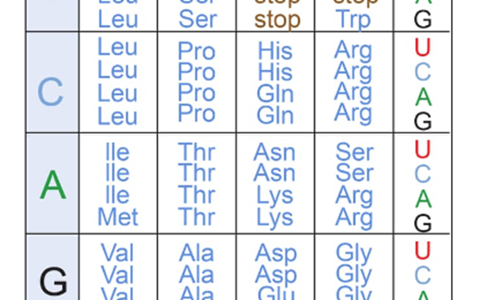

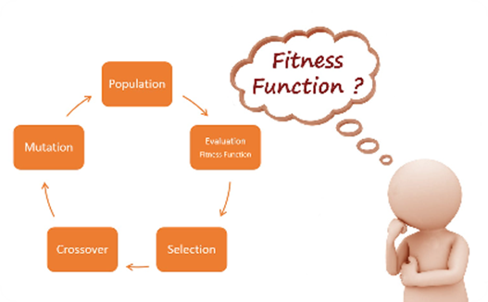
APPROACH/METHODOLOGY
Encoding Solutions
In this technique, chromosomes are coded in the form of integers. Each integer called gene is uniquely assigned to a certain course taught by a lecture. Sequence of integer representing genes in a chromosome, determines sequence of courses to be scheduled
Crossover and Mutation
One-point crossover is performed on two parent chromosomes.
And the chromosomes are mutated by swapping 2 genes.
Fitness Evaluation
Discover how a fitness function is used to evaluate the quality of candidate solutions.

Slide 11
Constraints in Predicate Logic form
Chromosome (Timetable) :
•Predicate: timetable(chromosome, day, hour, class, room)
•Description: Indicates whether a particular class is scheduled in a specific room at a given day and hour in the timetable.
•Example:
timetable(chromosome, d1, h1, c1, room_A) = 1 means that on day 1, hour 1, class 1 is scheduled in room A.
Available Rooms :
•Predicate: room_available(day, hour, room)
•Description: Indicates whether a room is available at the specified day and hour.
•Example: room_available(d1, h1, room_A) = 0 means that room A is not available on day 1, hour 1.

Slide 12
Mathematical Statements/Formulae Used
Entropy is calculated as:
→ If multiple classes of the same course are allocated in the same day, then entropy is 1 else 0.
Fitness is calculated as: fitness= (No. of scheduled units/Total no of units)​−∑ i=1 to N
([entropy(i)/N]​​×0.2)
where:
•N is the total number of classes.
•number of scheduled units number of scheduled units is the total number of units that have been scheduled in the timetable.
•total number of units total number of units is the total number of units that need to be scheduled for all classes.
•entropyᵢ​ is the entropy of the distribution of units per day for the i-th class.

Slide 13
01
Population formulation/ encoding process: formulate initial population
Here, in the first step a population having P chromosomes called individuals is generated by pseudo random
generators whose individuals represent a feasible solution. This is a representation of solution vector in a
solution space and is called initial solution.
02
03
04
05
06
Randomly initialize population
Evaluate objective function
Apply genetic operators
Reproduction
Crossover
07
08
09
Mutation
Repeat steps 3-7 until criteria is met
Return the optimal timetable
ALGORITHM

Slide 14
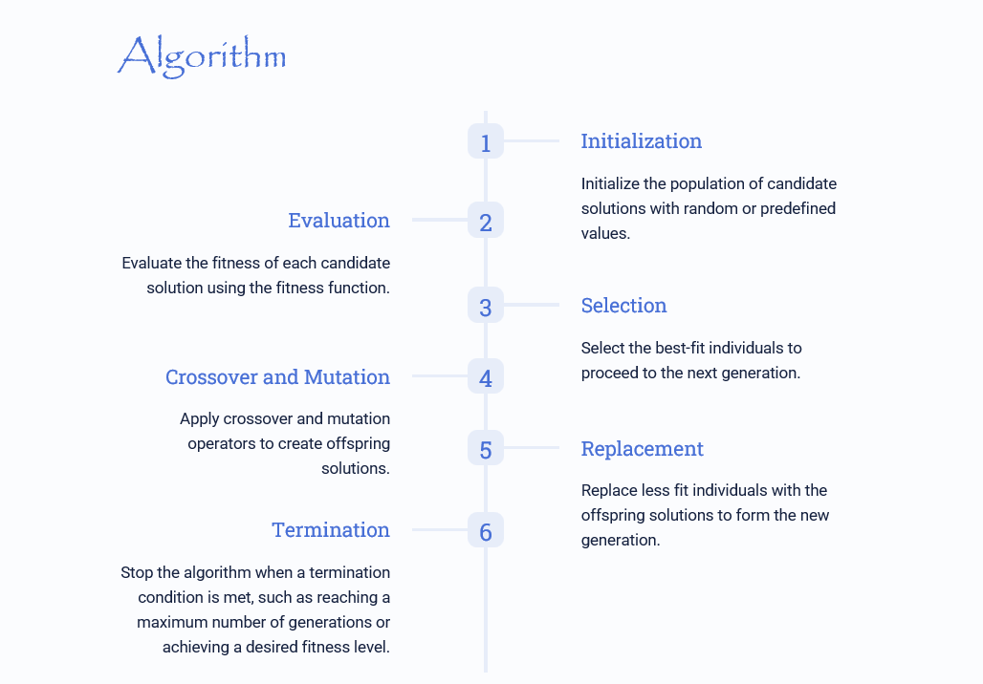

Slide 15
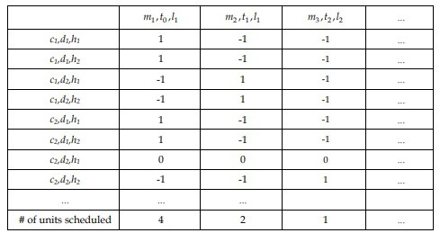
Table: Example of Target Matrix

Slide 16
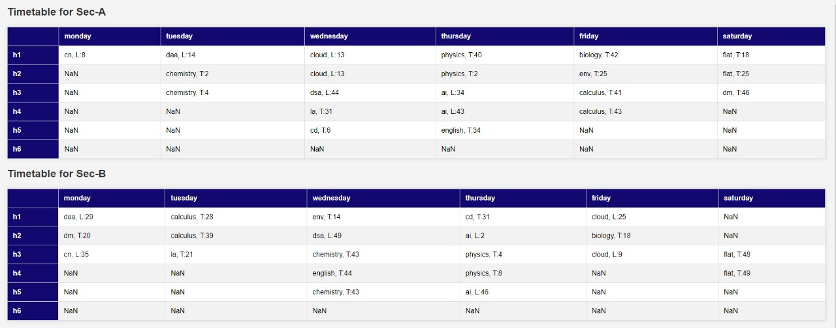
Sample Output

Slide 17
CONCLUSION
The proposed genetic algorithm and heuristic search adeptly identifies the rooms associated with specific timetable cells. Recognizing the pivotal role of room allocation, it becomes imperative to integrate this factor into the target matrix. Doing so necessitates transitioning to a three-dimensional target matrix, a crucial expansion for a more nuanced representation. This enhancement empowers the genetic algorithm and heuristic search to not only determine room assignments for specific time slots but also to optimize room allocations considering diverse constraints and preferences. This modification results in a more realistic and adaptable solution, accommodating the intricate interplay between time slots, courses, and suitable venues. Consequently, the algorithm gains the capability to optimize both event scheduling and efficient utilization of physical spaces. The integration of room allocation as a fundamental component of the target matrix significantly augments the algorithm's versatility and effectiveness in addressing the complex challenges inherent in timetable optimization.

Slide 18

Thank You!

